Slide 1

Pokémon Total Stats
by Type, Evolution, & . Legendary Status
Jordyn Lucier & Harley Clifton
Notes:
Harley

Slide 2






How Pokémon Works
1st
2nd
3rd
Find Them
Battle
Catch
Notes:
Jordyn

Slide 3

How it Works
Do Pokémon change over time?
As you train, they can level up, obtain buffs, gain abilities, and evolve. We will be simplifying the estimates of stats to the base stats at each evolution.
What differences between Pokémon are we accounting for?
Type, Secondary Type, and Evolution, Legendary Status
What are Legendary Pokémon?
The pokémon you get after beating the game They are oftentimes much stronger than normal pokémon They do not evolve
Notes:
Jordyn

Slide 4
1
Data & Research Question

Slide 5
How does Pokemon Type
impact overall stats?
Which Pokemon types tend to have the highest stats on average, after controlling for Evolution and Legendary Status?
Notes:
Harley

Slide 6

Our Data
The data set was sourced from Alberto Barradas on kaggle.com
Name | Unique for each evolution of each pokémon “species”
Type | Category of pokémon that determines what kind abilities it gets
Second Type | If they have a secondary type, what a pokémon’s secondary type if
Total Stats | Sum of each pokémon’s HP, Attack, Defense, Special Attack, Special Defense, & Speed
Generation | Pokémon games have been released in 6 generations over time
Evolution | = 1, 2, 3, 4. *Not all pokémon have all evolutions
Legendary Status | = 1 if observation is a legendary pokémon, 0 otherwise
Notes:
Jordyn

Slide 7


2
EDA & Data Visualization

Slide 8
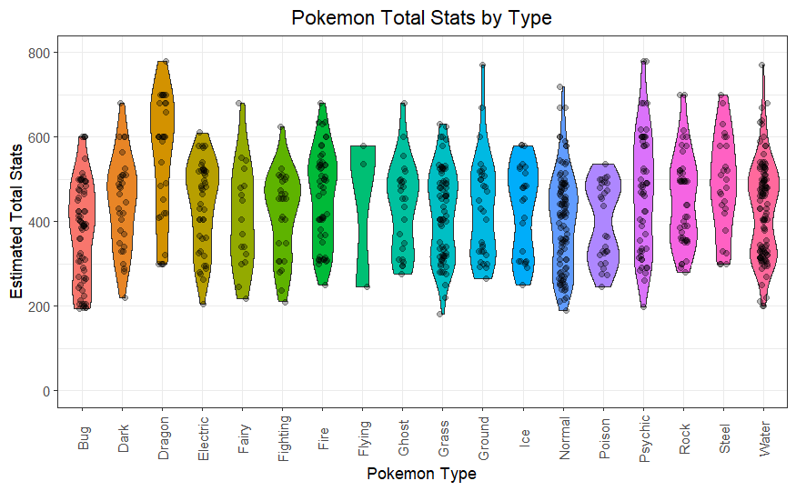

Slide 9
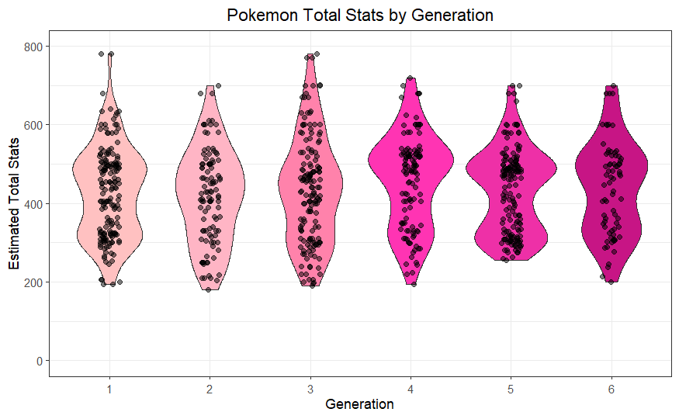

Slide 10
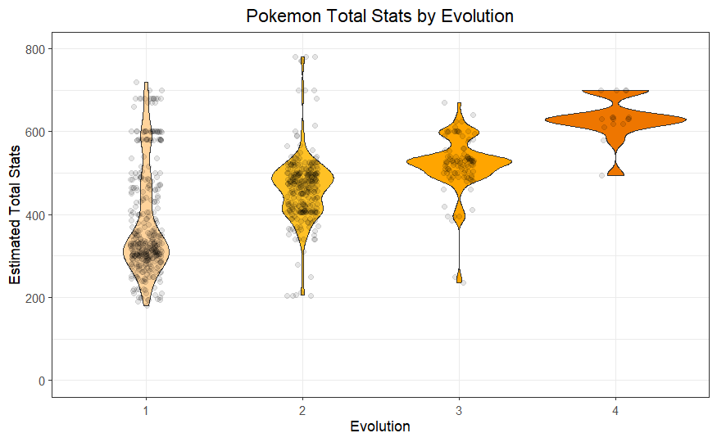

Slide 11
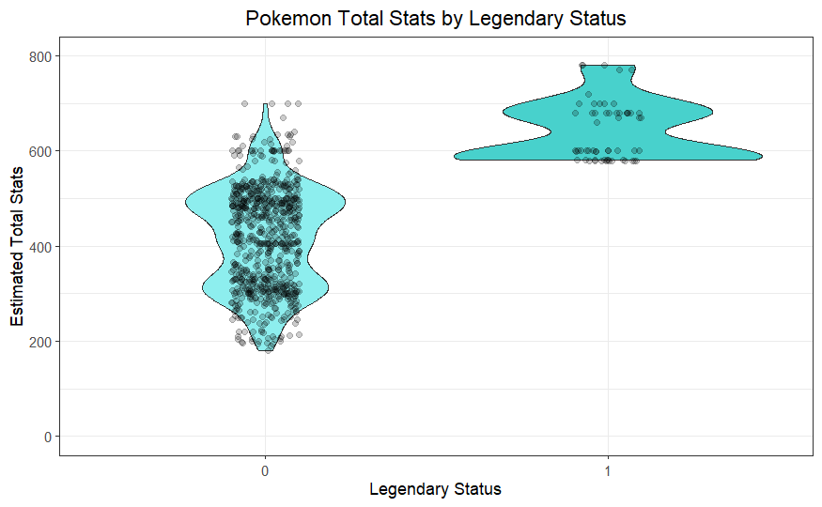

Slide 12

3
Descriptive Model & Priors

Slide 13

Sampling Model
Total Stats_{i} = ∑ 𝛽_{j} Pokémon Type + 𝛽₁₉ Evolution_{i} + 𝛽₂₀ Legendary_{i} + 𝜀_{i}
18
j=1
Where 𝜀_{i} ~ N(0, 𝜎²) and Legendary_{i} is an indicator variable for legendary status that is 1 when the pokemon is legendary and 0 otherwise.
Priors were formulated based on past experience playing Pokémon.
Notes:
Jordyn

Slide 14

4
Results

Slide 15

Estimated Average Total Stats
Pokémon Type | Mean Total Stats | 95% CI Lower Bound | 95% CI Upper Bound
Bug | 399.99 | 399.8 | 400.18
Dark | 382.90 | 355.22 | 411.38
Dragon | 398.78 | 370.78 | 427.48
Electric | 365.00 | 341.46 | 389.49
Fairy | 346.37 | 309.49 | 383.45
Fighting | 362.99 | 334.03 | 392.81

Slide 16

Estimated Average Total Stats
Pokémon Type | Mean Total Stats | 95% CI Lower Bound | 95% CI Upper Bound
Fire | 362.62 | 340.80 | 384.54
Flying | 412.18 | 346.81 | 478.31
Ghost | 366.56 | 336.02 | 397.10
Grass | 347.68 | 328.59 | 366.81
Ground | 359.23 | 331.70 | 386.55
Ice | 358.30 | 326.57 | 389.14

Slide 17

Estimated Average Total Stats
Pokémon Type | Mean Total Stats | 95% CI Lower Bound | 95% CI Upper Bound
Normal | 356.81 | 341.36 | 372.18
Poison | 354.53 | 325.85 | 383.37
Psychic | 362.39 | 340.40 | 385.15
Rock | 382.85 | 359.37 | 406.96
Steel | 377.10 | 347.23 | 407.62
Water | 362.62 | 347.25 | 378.04

Slide 18
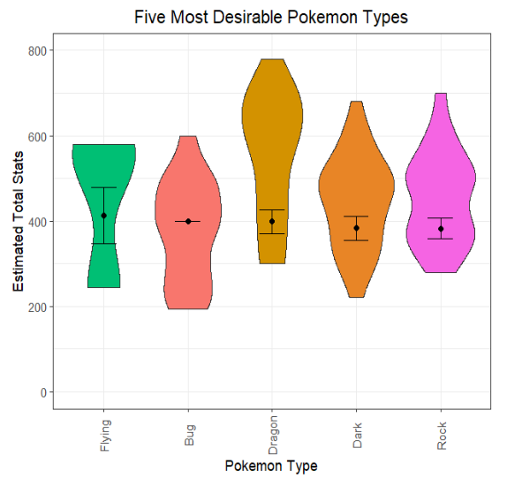
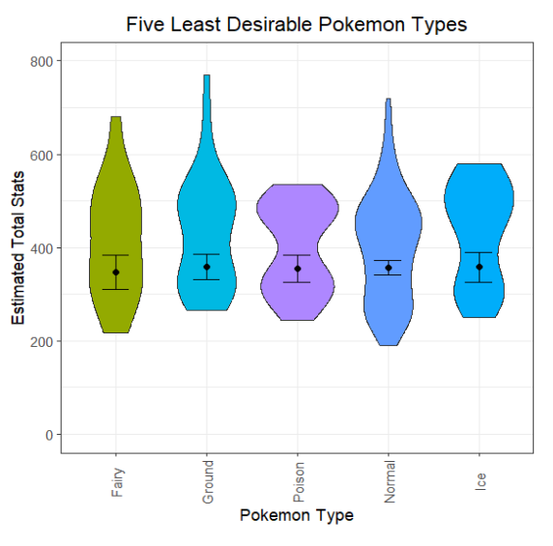
Results & Conclusions
Want: Flying, Bug, Dragon, Dark, Rock Avoid: Fairy, Ground, Poison, Normal, Ice
Notes:
Harley

Slide 19

Next Steps & Ideas for Further Research
Construct Posterior Predictive Distributions
Check that they mimic the data with reasonable accuracy
Seek data that includes the most recent Pokémon
Separate it by Pokémon game
Re-run analysis excluding legendary Pokémon
Notes:
Harley

Slide 20

5
References

Slide 21
Resources
Barradas, Alberto. “Pokemon With Stats.” Kaggle, 29 Aug. 2016, www.kaggle.com/datasets/abcsds/pokemon.
Martinez, Ismael. “Guy Naming Pokemon by the Wrong Name.” YouTube, 3 Aug. 2016, www.youtube.com/watch?v=ha0VNUt3YjM.
Plummer, Martyn. The rjags Package: Bayesian Graphical Models using MCMC (2022). R package version 4-13. https://CRAN.R-project.org/package=rjags.
R Core Team. R: A language and environment for statistical computing (2021). R Foundation for Statistical Computing, Vienna, Austria. https://www.R-project.org/.
Wickham, Hadley. The ggplot2 Package: Elegant Graphics for Data Analysis (2016). Springer-Verlag New York. https://ggplot2.tidyverse.org.
Notes:
Jordyn

